Slide 1
Cold Start

Slide 2
What is Cold Start
S
X
L
Item Cold Start
Each time a new item is added to the system, it goes through the cold start phase due to the lack of valuable user interactions.
User Cold Start
The user or visitor cold start simply means that a recommendation engine meets a new visitor for the first time. because there is no user history about her, the system doesn’t know the personal preferences of the user. Getting to know your visitors is crucial in creating a great user experience for them.
Device Cold Start
Even if users allow cookies in their browser, they can still experience the cold start. This can happen, for example, when they use someone else’s computer to browse, or simply if they have multiple devices. Classified sites cannot link their user history from their different devices if they don’t have an account.

Slide 3
Why is Cold Start A Problem
S
X
L
Recommendation engines that run on collaborative filtering recommend each item (products advertised on your site) based on user actions. The more user actions an item has, the easier it is to tell which user would be interested in it and what other items are similar to it. As time progresses, the system will be able to give more and more accurate recommendations.
This, however, brings a major contradiction and difficulty to classified sites and their recommendation engines. Even though the newest ads are actually the most relevant ones, a recommendation system has far less confidence in recommending them to your users than it has with older items, but it’s just simply not a good idea to let older ads dominate the recommendation process.

Slide 4
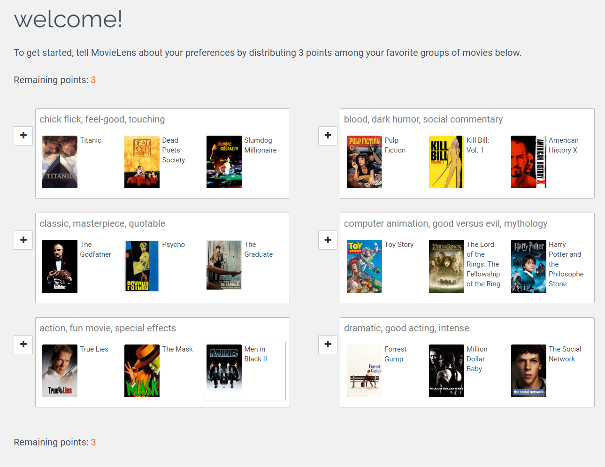
How To Deal With Cold Start
Profile completion (Preference elicitation)
Rapidly acquire some preference data from cold users
For example MovieLens, a web-based recommender system for movies, asks the user to rate some movies as a part of the registration.

Slide 5
How To Deal With Cold Start
S
X
L
Item Cold Start
Content-based filtering is the method that answers this question
User Cold Start
By default, the very first step is to apply a popularity based strategy. Trending products can be determined by global trends and what’s been popular recently, regionally, or at that certain time of the day. Then as a next step, you can narrow the selection of ads you display for visitors by making use of contextual information
Device Cold Start
Geolocating users with either their geoIP or their mobile device’s GPS co-ordinates.
Knowing the referrer (which site the visitor came from), the device (mobile, desktop), the operating system (iOS, Windows, Android) and the browser type (Chrome, IE, Safari, etc) will help with personalizing the ads you display.

